Slide 1


PORDUCT DATA ANALYSIS

Slide 2
Background
Dataset of product information.
Relationship between sports goods, banner ads, and purchasing.
Assumptions:
Banner displayed within the confines of the main sporting good website (as per instructions).
Users display reasonable behaviour (more on that soon...)

Slide 3
Two Main Topics of Interest
User-based information intrinsic within the data
Efficacy of the banner system as a tool for driving sales
What trends can we see?
What impact does time play?
Which site versions show most promise?
Which products sell best?
Impact of banner views on driving sales?
Relationship between # of views and % likelihood of sale?
Is the banner “working”?

Slide 4
Part 1 – User based information
The major metrics ripe for analysis are:
Time: When banner views, click and purchases happened.
Site Version: Whether the action came off of a mobile phone or desktop.
Product: Which of the five categories (clothes, accessories, company, sneakers, sports nutrition) was advertised in the banner.

Slide 5
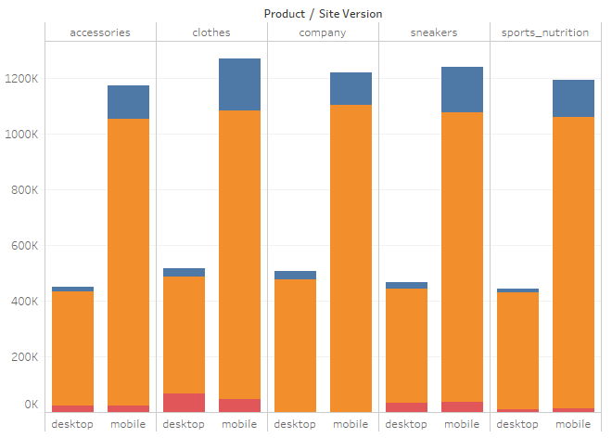

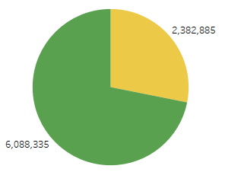

Q. What are the major differences between site versions?
The ratio of people being shown different products is relatively equal.
A majority of user interactions occur via mobile (72%) vs desktop (28%).
# of interactions
But if we look at this in terms of proportions…

Slide 6
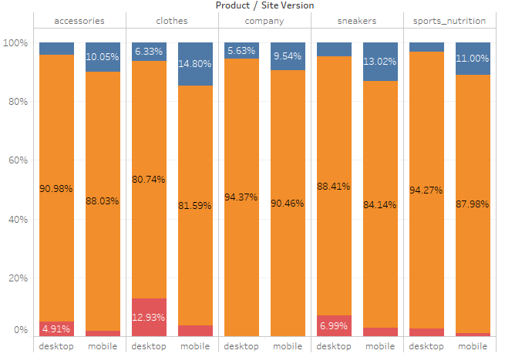

Q. What are the major differences between site versions?
…we find that proportionally, Desktop outstrips mobile in terms of orders being made in every category.
Mobile is far more likely to accrue banner clicks, without leading to a proportional number of orders on the same device.

Slide 7
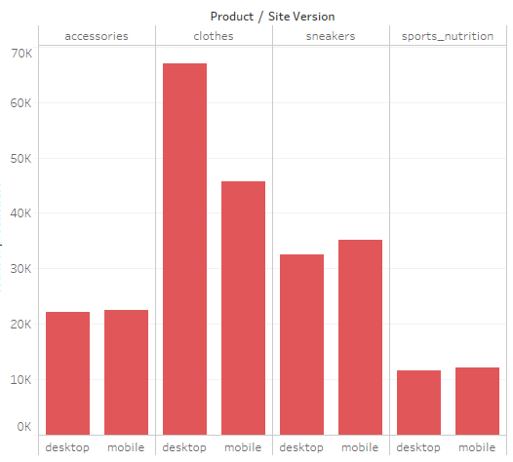
Q. What are the major differences between site versions?
Does this mean people are more likely to order if they’re on a desktop? Or do they see the product on their phone and then order later on their desktop?
(This largely holds true even in absolute values)
Thus, though mobile drives views and clicks, desktop drives ordering.
# of interactions

Slide 8
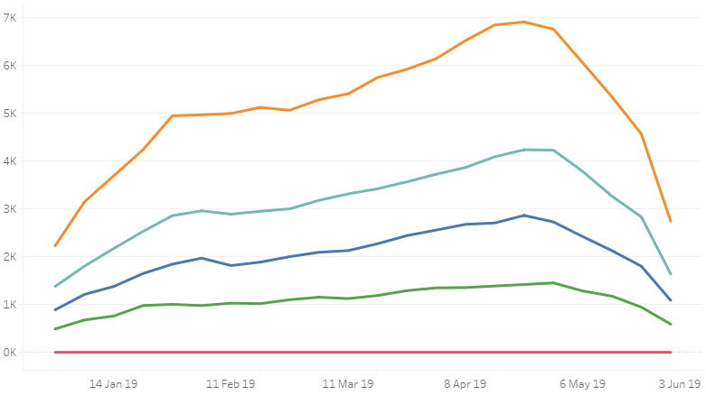
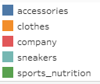
Q. What products are most popular?
# of purchases
Clothes are the most purchased product, followed by sneakers and accessories (company isn’t a saleable product)
As we showed before, this is independent of the actual level of banner advertisement
This problematises the idea that banner views/clicks are making an impact if we assume the efficacy of the banner ads should be the same for each.
Week

Slide 9
Q. Is there seasonality?
# of purchases
Aside from that, this graph also clearly shows seasonality, with a low post-Christmas/NY period, a strong April-May (late Autumn sales in SH?) and drops going into June.
Week

Slide 10
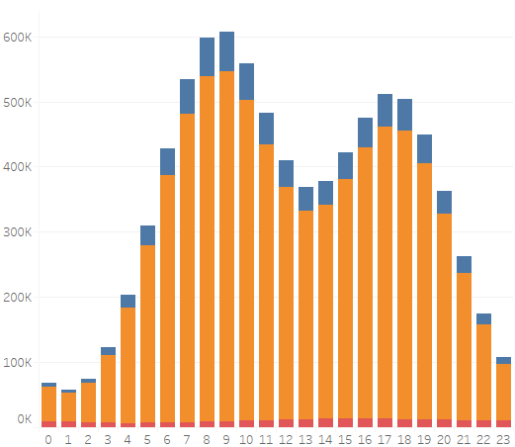
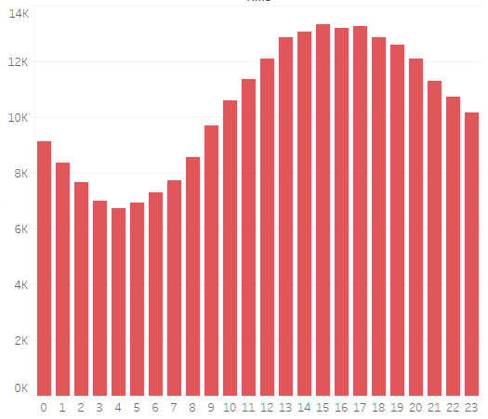
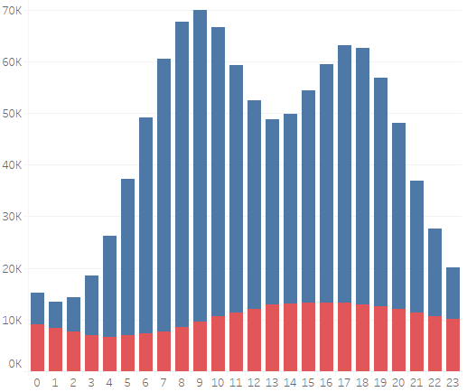

Q. What relationship is there between time of day and sales?
User interactions over the day are roughly bimodal, with peaks around 7 – 10am and 4 – 7 pm.
This may indicate that the website largely operates in one country (or at least a narrow time zone) as user interactions are focussed on pre/post work hours.
Interestingly enough, actual orders show much less variance.
# of interactions
This further problematises the banner view → banner click → order funnel, as there is a weak relationship between clicking and ordering.
Hour of day

Slide 11
Part 2 – Efficacy of banner system
The previous insights raised some questions about banner efficacy.
There are three distinct “actions” that can be performed in relation to the existence of the banner on the main page.
Banner view: The banner is viewed, displaying a random product from a selection of 5 options.
Banner click: The banner is clicked on, showing user engagement. Must be in conjunction with a pre-ceding banner view.
Order: A sale is made. Does not need to be in conjunction with a banner click.

Slide 12
Q. What is the relationship between total # of banner views and actual purchases?
We had 4.2M unique users, although only 249K orders across 238K unique purchasers (5.59%).
Remarkably linear relationship between number of banner views and likelihood of making (or having made) a purchase: 4% off one view, to 41% off of 14.
Users within the dataset saw a banner up to 14 times, though >93% saw 1 – 3.

Slide 13
So does this mean that more banner views = more chance of purchasing?
Not necessarily…it’s equally possible that users who make up their mind to purchase products simply access the main page multiple times to decide or complete a transaction.
What’s missing is the element of time.

Slide 14
Q. How many users who purchase a product do so before ever having seen a banner?
Of the 249K product purchases…
…96K (38.7%) happen before every having seen a single banner.

Slide 15
It isn’t unexpected that a fair % of users would buy products off the website without having seen advertising on the website itself.
But it does problematise the assumption of banner efficacy. To really know the efficacy, we need to figure out the user funnel.
Users who buy products
Users who buy products before seeing a single banner
Users who see a banner
Users who buy product unrelated to seeing banner
Users who buy product as a result of seeing banner
Users who click on banner
Users who buy product unrelated to clicking on banner
Users who buy product as a result of clicking on banner

Slide 16
100%
20.27%
10.04%
4.06%
So after analysis what was found is as follows…
Of the 249K users who bought a product…
Only 20% made a purchase at some point in time after seeing a banner for the product. BUT…
Only 10% made a purchase within 14 days of seeing the banner (unlikely to be related).

Slide 17
100%
20.27%
10.04%
4.06%
4% were within 5 days (possible but a stretch).
0.87% were within 24 hours (getting more believable).
0.34% were within 6 hours (typical behaviour).
…and just 0.09% were a direct result of banner view → banner click → order (inside of 6 hour period).

Slide 18
We can therefore assert with reasonable certainty that a user purchase funnel of banner view → banner click → order simply doesn’t exist – it accounts for only 230 sales in 6 months of data (1.26 sales a day).
The evidence of banner views is equally tenuous: even if we believe that a user is able to remember the banner content for up to 14 days, no greater than 10% of purchases can be linked to the banner.
If we assume a much more reasonable 24 hours, this drops to <1%.
Based on this evidence it can be argued that the banner could be put to better use, such as selling out ad space for a PPC model.
- (829K clicks * $/click)

